Slide 1
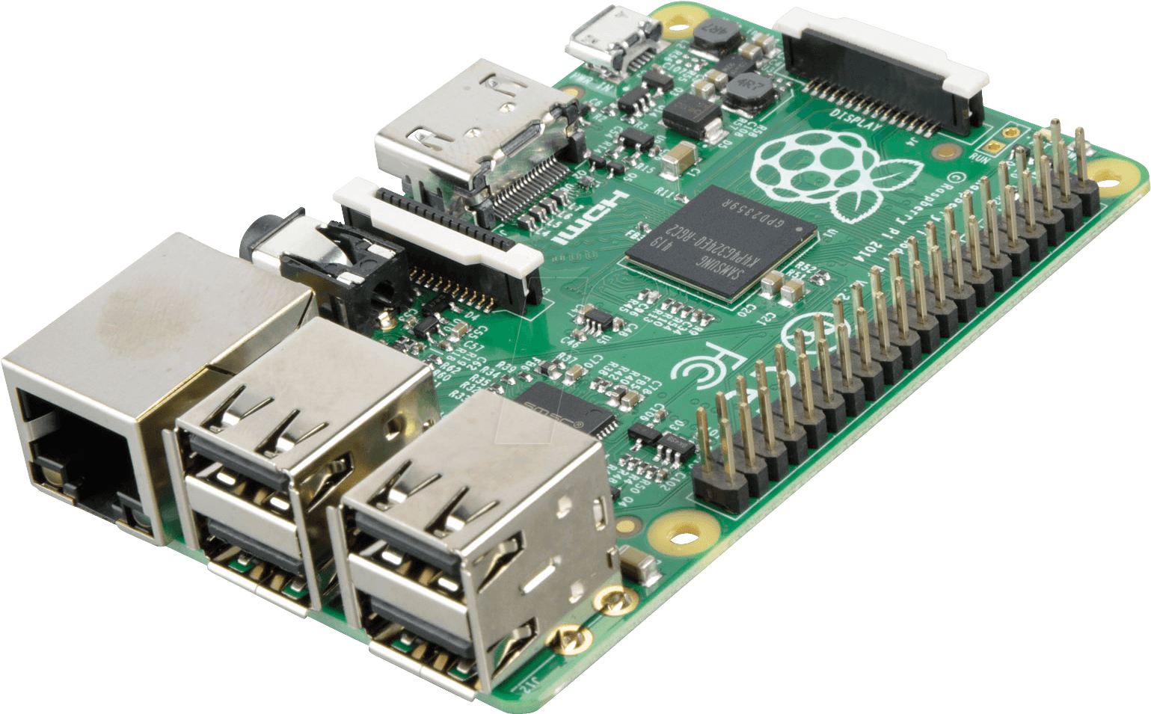

Pertemuan 8
Image Processing Part 4
Pengenalan Scikit-Image Library
Thresholding Li
Thresholding Yen
Thresholding Sauvola
Belajar
Image Processing di Raspberry Pi

Slide 2
Pengenalan Scikit-Image Library

Slide 3
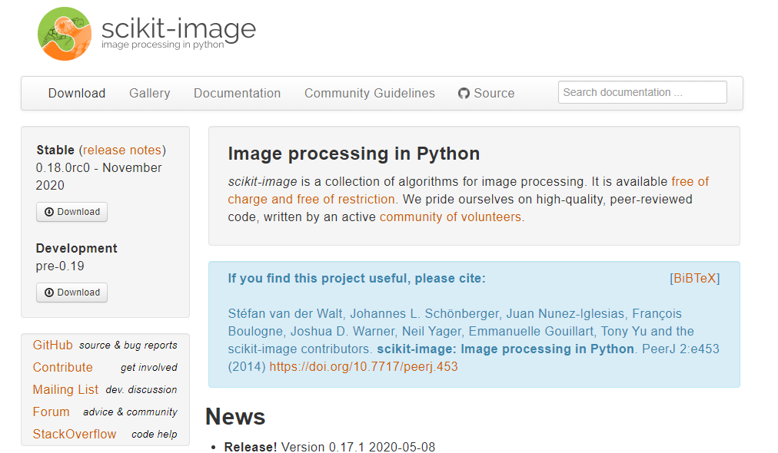
Scikit-Image
scikit-image (formerly scikits.image) is an open-source image processing library for the Python programming language.[2]
It includes algorithms for segmentation, geometric transformations, color space manipulation, analysis, filtering, morphology, feature detection, and more.[3]
https://en.wikipedia.org/wiki/Scikit-image
https://scikit-image.org/

Slide 4
Thresholding Li

Slide 5
Thresholding Li
Thresholding Li : Compute threshold value by Li’s iterative Minimum Cross Entropy method.
skimage.filters.threshold_li(image, *, tolerance=None, initial_guess=None, iter_callback=None)
Parameters :
image : ndarray, input image
tolerance : float, optional
initial_guess : float or Callable[[array[float]], float], optional
iter_callback : Callable[[float], Any], optional
Return :
threshold : float
Code :
https://scikit-image.org/docs/stable/api/skimage.filters.html#skimage.filters.threshold_li
Paper :
Li C.H. and Lee C.K. (1993) “Minimum Cross Entropy Thresholding” Pattern Recognition, 26(4): 617-625 DOI:10.1016/0031-3203(93)90115-D

Slide 6
Thresholding Li
Import library (OpenCV, Matplotlib, Scikit Image)
import cv2
import matplotlib.pyplot as plt
import os
import skimage.filters as flt
read Image
img = cv2.imread('/path/to/filename')
convert to gray
def convert_gray(img):
gray_img = cv2.cvtColor(img, cv2.COLOR_BGR2GRAY)
return gray_img
gray = convert_gray(img)

Slide 7
Thresholding Li
calculate Thresholding Li
thresh_Li = flt.threshold_li(gray)
calculate Thresholding Li
ret, binary_Li = cv2.threshold(gray, thresh_Li, 255, cv2.THRESH_BINARY)
Display Image
def show_image_binary(binary, title= 'my image', size=(10, 7)):
plt.figure(figsize=size)
plt.imshow(binary, cmap='gray')
plt.title(title)
plt.axis('off')
plt.show()
show_image_binary(binary_Li,
title= 'Thresholding Li (%d)' % thresh_Li)

Slide 8
Thresholding Li Keseluruhan Kode
keseluruhan kode thresholding Li
import cv2
import matplotlib.pyplot as plt
import os
import skimage.filters as flt
img = cv2.imread('/path/to/filename')
gray = convert_gray(img)
thresh_Li = flt.threshold_li(gray)
binary_Li = cv2.threshold(gray, thresh_Li, 255, cv2.THRESH_BINARY)
show_image_binary(binary_Li, title= 'Thresholding Li (%d)' % thresh_Li)

Slide 9
Thresholding Li dalam function
membuat function thresholding Li
def li(gray):
thresh_Li = flt.threshold_li(gray)
ret, binary_Li = cv2.threshold(gray, thresh_Li, 255, cv2.THRESH_BINARY)
return thresh_Li, binary_Li
memanggil function thresholding Li
img = cv2.imread('/path/to/filename')
gray = convert_gray(img)
thresh_Li, binary_Li = li(gray)
show_image_binary(binary_Li, title= 'Thresholding Li (%d)' % thresh_Li)

Slide 10
Thresholding Li vs Otsu
function otsu
def otsu(gary):
ret, binary= cv2.threshold(gray, 0, 255, cv2.THRESH_BINARY + cv2.THRESH_OTSU )
return ret, binary
thresholding Li vs Otsu
img = cv2.imread('/path/to/filename')
gray = convert_gray(img)
thresh_Li, binary_Li = li(gray)
thresh_Otsu, binary_Otsu = otsu(gray)
show_image_binary(binary_Li, title= 'Thresholding Li (%d)' % thresh_Li)
show_image_binary(binary_Otsu, title= 'Thresholding Otsu (%d)' % thresh_Otsu)

Slide 11
Thresholding Yen

Slide 12
Thresholding Yen
Thresholding Yen : Return threshold value based on Yen’s method.
skimage.filters.threshold_yen(image, nbins=256)
Parameters :
image : ndarray, input image
nbins : int
Return :
threshold : float
Code :
https://scikit-image.org/docs/stable/api/skimage.filters.html#skimage.filters.threshold_yen
Paper :
Yen J.C., Chang F.J., and Chang S. (1995) “A New Criterion for Automatic Multilevel Thresholding” IEEE Trans. on Image Processing, 4(3): 370-378. DOI:10.1109/83.366472

Slide 13
Thresholding Yen
read Image
img = cv2.imread('/path/to/filename')
convert to gray
gray = convert_gray(img)
calculate Thresholding Yen
thresh_Yen = flt.threshold_yen(gray)
calculate Thresholding Yen
ret, binary_Yen = cv2.threshold(gray, thresh_Yen, 255, cv2.THRESH_BINARY)
Display Image
show_image_binary(binary_Li, title= 'Thresholding Li (%d)' % thresh_Li)

Slide 14
Thresholding Yen Keseluruhan Kode
keseluruhan kode thresholding Yen
import cv2
import matplotlib.pyplot as plt
import os
import skimage.filters as flt
img = cv2.imread('/path/to/filename')
gray = convert_gray(img)
thresh_Yen = flt.threshold_yen(gray)
binary_Yen = cv2.threshold(gray, thresh_Yen, 255, cv2.THRESH_BINARY)
show_image_binary(binary_Yen, title= 'Thresholding Li (%d)' % thresh_Yen)

Slide 15
Thresholding Yen dalam function
membuat function thresholding Yen
def yen(gray):
thresh_Yen = flt.threshold_yen(gray)
ret, binary_Yen = cv2.threshold(gray, thresh_Yen, 255, cv2.THRESH_BINARY)
return thresh_Yen, binary_Yen
memanggil function thresholding Yen
img = cv2.imread('/path/to/filename')
gray = convert_gray(img)
thresh_Yen, binary_Yen = yen(gray)
show_image_binary(binary_Yen, title= 'Thresholding Yen (%d)' % thresh_Yen)

Slide 16
Thresholding Li vs Yen vs Otsu
thresholding Li vs Yen vs Otsu
img = cv2.imread('/path/to/filename')
gray = convert_gray(img)
thresh_Li, binary_Li = li(gray)
thresh_Yen, binary_Yen = yen(gray)
thresh_Otsu, binary_Otsu = otsu(gray)
show_image_binary(binary_Li, title= 'Thresholding Li (%d)' % thresh_Li)
show_image_binary(binary_Yen, title= 'Thresholding Yen (%d)' % thresh_Yen)
show_image_binary(binary_Otsu, title= 'Thresholding Otsu (%d)' % thresh_Otsu)

Slide 17
Thresholding Li vs Yen vs Otsu Multiple Image
fungsi crop
def crop(img, y_min, y_max, x_min, x_max):
crop_img = img[y_min:y_max, x_min:x_max, :]
return crop_img
fungsi reize
def resize(img, size=(320,240)):
resize_img = cv2.resize(img, size)
return resize_img

Slide 18
Thresholding Li vs Yen vs Otsu Multiple Image
fungsi crop & resize
def crop(img, y_min, y_max, x_min, x_max):
crop_img = img[y_min:y_max, x_min:x_max, :]
return crop_img
def resize(img, size=(320,240)):
resize_img = cv2.resize(img, size)
return resize_img

Slide 19
Thresholding Li vs Yen vs Otsu Multiple Image
h_crop = 200
w_crop = 200
filenames = os.listdir("folder_1")
for name in filenames :
print(name)
img = cv2.imread("folder_1/" + name)
h, w, c = img.shape
y_min = int((h - h_crop)/2)
y_max = y_min + h_crop
x_min = int((w - w_crop)/2)
x_max = x_min + w_crop
print(y_min, y_max, x_min, x_max)
crop_img = crop(img, y_min, y_max, x_min, x_max) # crop 20% atas, bawah, kanan, kiri
h, w, c = crop_img.shape
resize_img = resize(crop_img, size=(w*2, h*2)) # rescale 2x lebar dan tinggi
gray = convert_gray(resize_img) # convert to grayscale
thresh_Li, binary_Li = li(gray)
thresh_Yen, binary_Yen = yen(gray)
thresh_Otsu, binary_Otsu = otsu(gray)
show_image_binary(binary_Li, title= 'Thresholding Li : %s (%d)' % (name, thresh_Li))
show_image_binary(binary_Yen, title= 'Thresholding Yen : %s (%d)' % (name, thresh_Yen))
show_image_binary(binary_Otsu, title= 'Thresholding Otsu : %s (%d)' % (name, thresh_Otsu))

Slide 20
Thresholding Sauvola

Slide 21
Thesholding Sauvola (local thresholding)
Applies Sauvola local threshold to an array. Sauvola is a modification of Niblack technique.
skimage.filters.threshold_sauvola(image, window_size=15, k=0.2, r=None)
Parameters :
image : ndarray, input image
window_size : int (single odd integer)
k : float (positive parameter)
r : float (dinamic range std)
Return :
threshold : ndarray
Code :
https://scikit-image.org/docs/dev/api/skimage.filters.html#skimage.filters.threshold_sauvola
Paper :
J. Sauvola and M. Pietikainen, “Adaptive document image binarization,” Pattern Recognition 33(2), pp. 225-236, 2000. DOI:10.1016/S0031-3203(99)00055-2

Slide 22
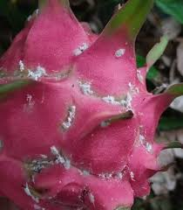
Thesholding Sauvola (local thresholding)
window_size
image height
window_size
T (threshold) is calculated for every pixel in the image using the following formula :
T = m(x,y) * (1 + k * ((s(x,y) / R) - 1))
where m(x,y) and s(x,y) are the mean and standard deviation of pixel (x,y) neighborhood defined by a rectangular window size w x w.
image width

Slide 23
Thresholding Sauvola (local thresholding)
read Image
img = cv2.imread('/path/to/filename')
convert to gray
gray = convert_gray(img)
calculate Thresholding Yen
thresh_Sauvola = flt.threshold_sauvola(image, window_size=25, k=0.2)
calculate Thresholding Yen
binary_Sauvola = cv2.threshold(gray, thresh_Sauvola, 255, cv2.THRESH_BINARY)
Display Image
show_image_binary(binary_Sauvola, title= 'Thresholding Sauvola')

Slide 24
Thresholding Sauvola (local thresholding)
show Sauvola threshold value
thresh_sauvola = np.int0(thresh_sauvola)
thresh_sauvola_unique = np.unique(thresh_sauvola)
print(thresh_sauvola_unique)
plt.imshow(thresh_sauvola, cmap="gray")

Slide 25
Sumber
https://scikit-image.org/docs/dev/auto_examples/segmentation/plot_thresholding.html
https://scikit-image.org/docs/stable/auto_examples/segmentation/plot_niblack_sauvola.html

